Slide 1

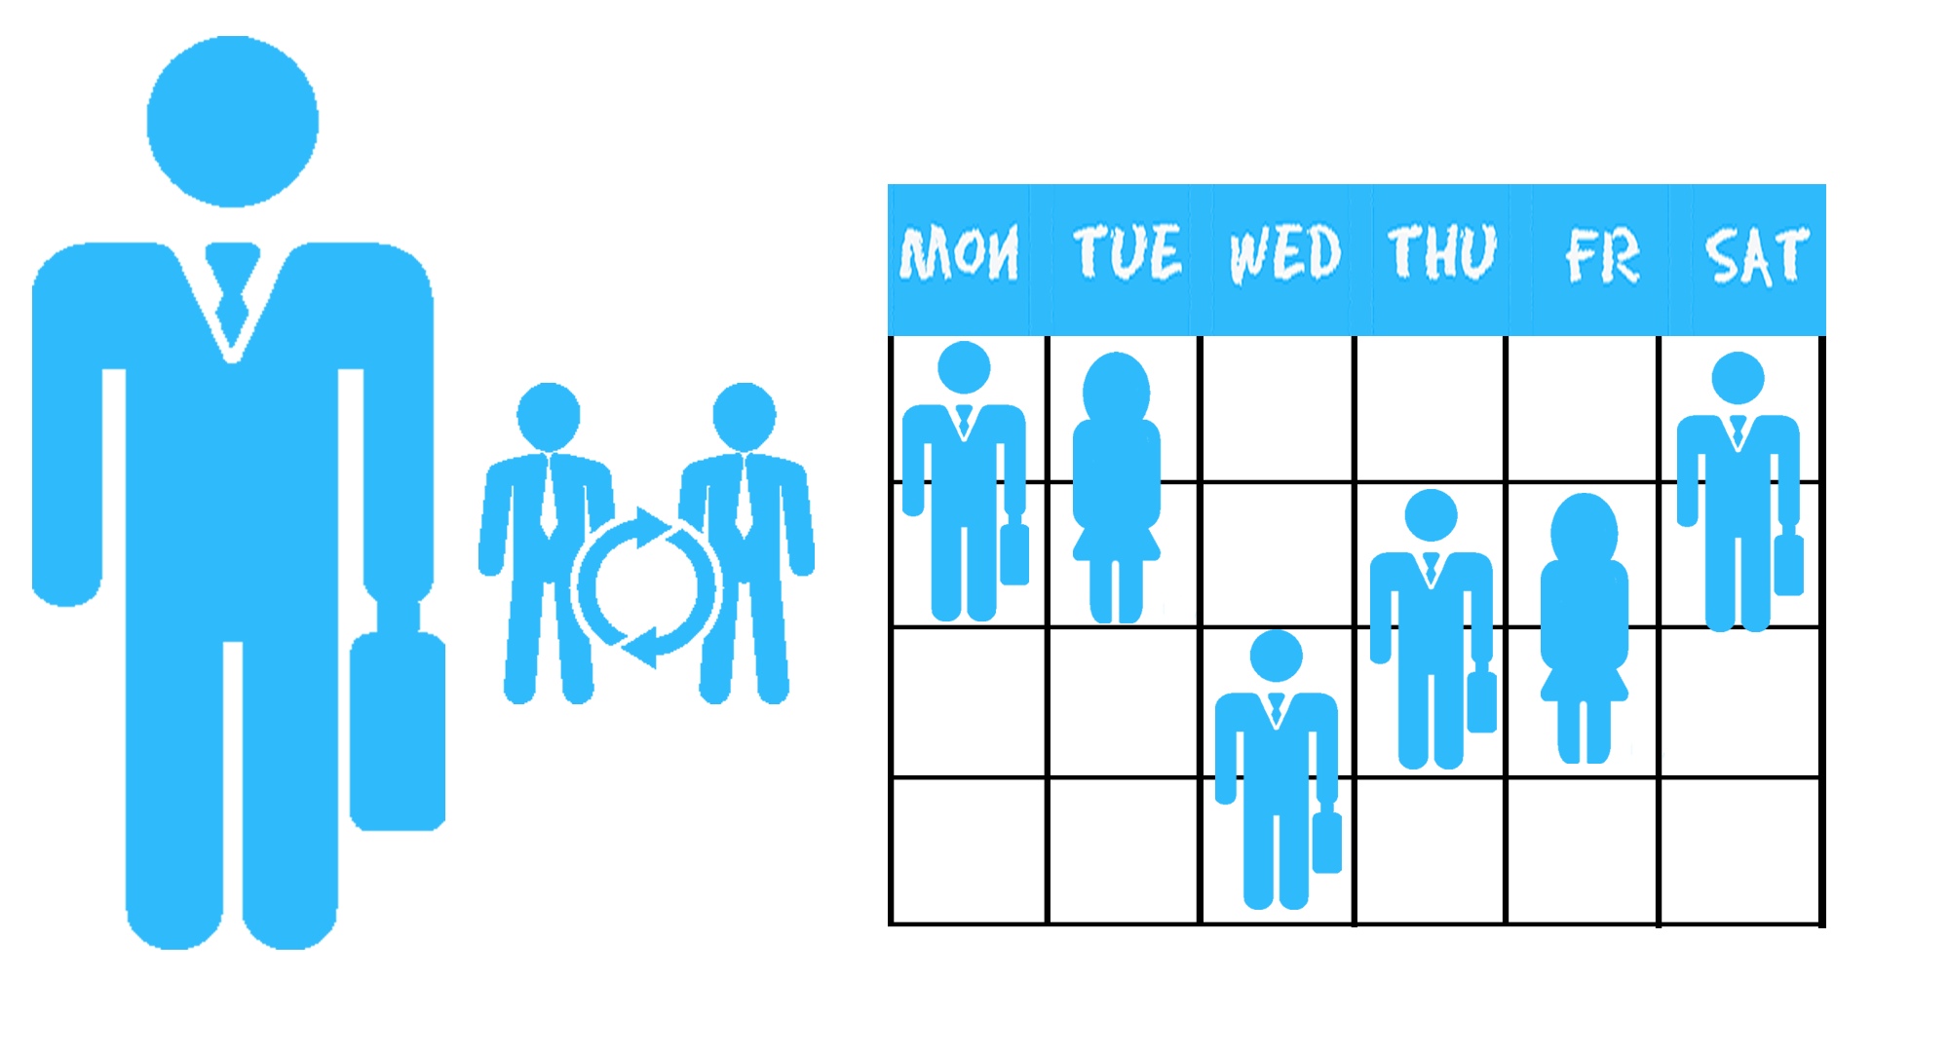
Playground.2019A.lazar
Aviv Lazar, Shay Rashinsky , liran Nachman, Tal Israeli

Slide 2
Introduction to Playground.2019A.lazar
Our goal is to create a platform where players can play and have fun, having the option to choose between being a player or a manager.
We will do this by creating an abstract system where any elements can be integrated following a simple API, this will make the game fun for the users and can be expanded by other developers.

Slide 3
Introduction to Playground.2019A.lazar
Our elementives:
Make money through Ads in the product, this would be considered a success if we will cover our expenses and have a yearly revenue of 50k dollars.
Create a product that will satisfy our customers, this would be considered a success if we get over 80% positive reviews in our customer satisfaction surveys within 6 months since our launch.

Slide 4
Scope of Playground.2019A.lazar
The Playground.2019A.lazar is an online platform where 2 types of users would be able to play as Managers or Players with different functionalities to each, with progress being saved in a database
The Application will be free for download and will work on windows 8 and 10.
The Application will require an internet connection and won't work without it.

Slide 5
Actors of the Project
Our Customers are every person wants to have fun a don’t mind too much about having adds on his game.
We have two of types of Users:
Manager- Noob level, no experience requirement. . Their goal is to create and remove stuff from the game.
Players– Noob level, no experience requirement. goals is to have fun using game elements that the managers create and getting points while. (giving them using options to other game elements)
No secondary users , No maintenance users.

Slide 6
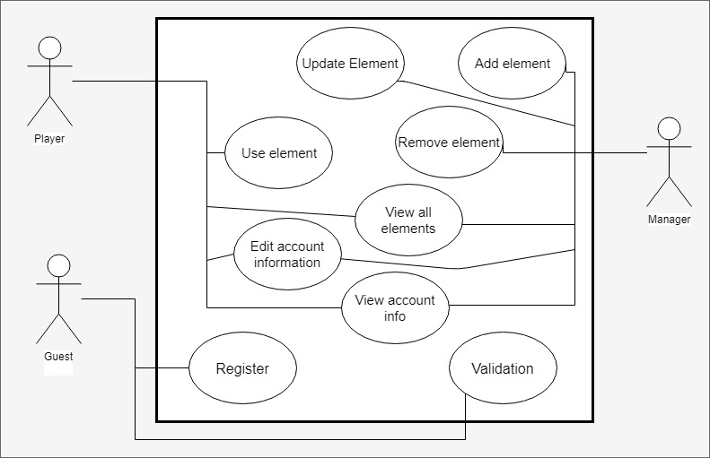
Use Case UML

Slide 7
Functional requirements
Add element
Description: The manager shall have the ability
to add element (from existing elements) to the game.
Rational: To give a manager the ability to
Add an element.
Actors: Manager(Primary),
Flow
Manager | System
Manager login
 | Verify Manager
Manager add an element
 | System receive the element

Slide 8
Add element
Alternate Flow
Manager | System
Manager login
 | Verify Manager
Manager add an element
 | Addition fail

Slide 9
Remove element
Description: The manager shall have the ability
to remove an element (from in-game
elements) from the game.
Rational: Give the ability to a manager to remove
a current element from the game.
Actors: Manager (Primary).
Flow
Manager | System
Manager login
 | Verify Manager
Manager remove an element
 | System remove the element.

Slide 10
Remove element
Alternate Flow
Manager | System
Manager login
 | Verify Manager
Manager remove an element
 | Removal fail
Manager | System
Manager still see the element in the game and re-remove it
 | System remove the element

Slide 11
Put element to another element
Description: Player put one element inside another element.
Rational: Give the player the ability to put elements in other elements
Actors: Player(primary).
Flow
Player | System
Player login
 | Verify Player
Player put one element in another
 | System update the elements

Slide 12
Put element to another element
Alternate Flow
Player | System
Player login
 | Verify Player
Player put one element in another element
 | System fail to put the element
Player doesn’t see the required change
Player repeat the previous action
 | System update the elements

Slide 13
Use element
Description: The Player shall have the ability to elements
Rational: Give Players the ability to have interaction with elements thus creating more interest
Actors: Player(Primary)
Flow
Player |  | System
Player login
 |  | Verify Player
Player use element
 |  | System update

Slide 14
Use element
Alternate Flow
Player |  | System
Player login
 |  | Verify Player
Player Use element
 |  | System fail to recognize element
Player reuse element
 | System fail to recognize element

Slide 15
View all elements
Description: The Users shall the ability to see all
The elements in the game
Rational: Give Users the see what options they
Have (element wise)
Actors: Manager(Primary).
Player(primary).
Flow
User |  | System
User login
 |  | Verify User
User view elements
 |  | System displays all elements

Slide 16
View all elements
Alternate Flow
Player/Manager |  | System
User login
 |  | Verify User
User view elements
 |  | System displays nothing
User understand there are no elements

Slide 17
Flow
User |  | System
User login
 |  | Verify User
User view account information
 |  | system displays account information
View Account Information
Description: The Users shall have the ability to view their account data
Rational: Users should have the power to see what is their account information and
Actors: Manager(Primary).
Player(Primary).

Slide 18
View Account Information
Alternate Flow
User |  | System
User login
 |  | Verify User
User view account information
 |  | System display gibberish
User confused

Slide 19
Nonfunctional Requirements
Useability-
Til 1,000 players can be in the system at the same time.
Supporting by Windows 8 and 10.
Reliability-
The player would log in to the system by an email and a password.

Slide 20



Division of labor
Liran:
Devops
Database Administrator
Tal:
Scrum Master
Aviv:
Team Leader
QA
Shay:
Product Owner

Slide 21
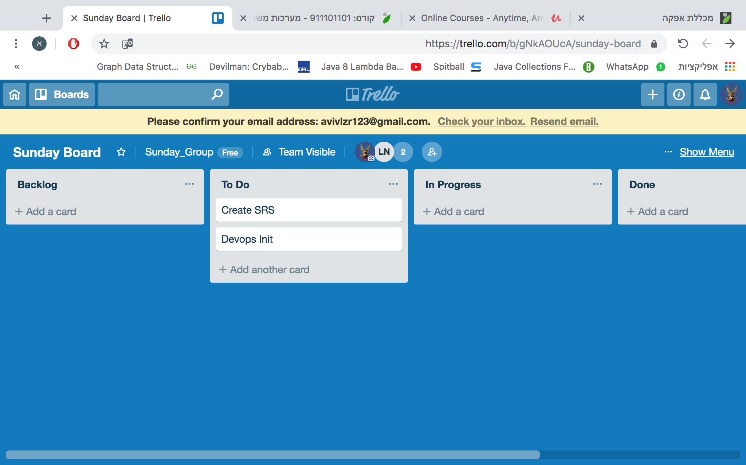
Sprint 1

Slide 22
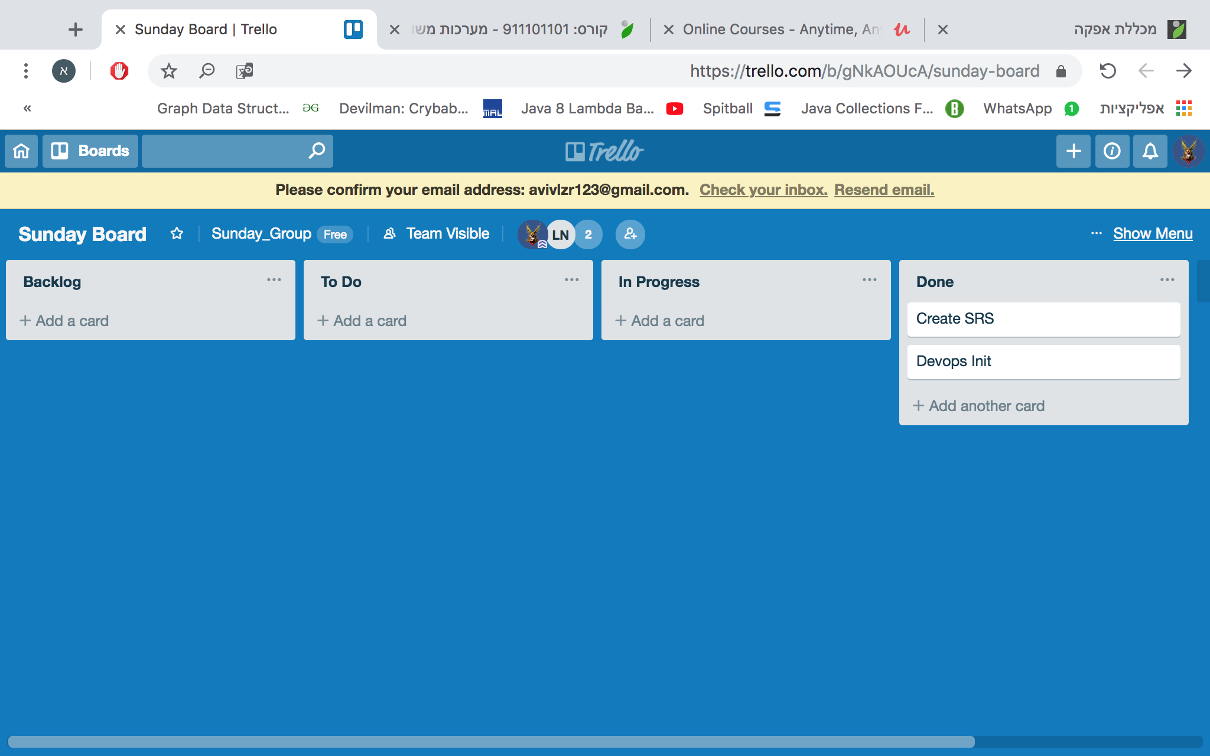

Slide 23
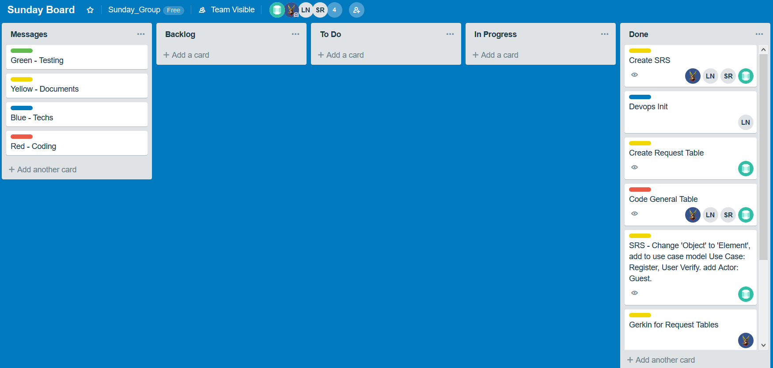
Sprint 2

Slide 24
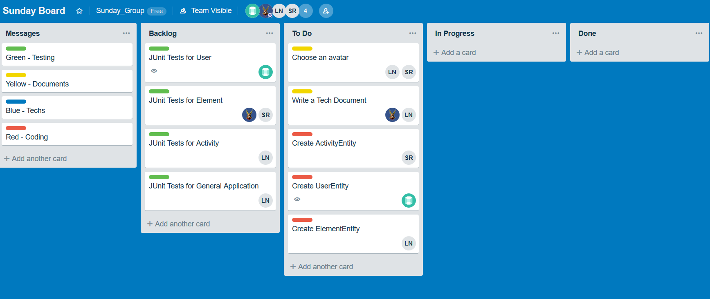
Sprint 3

Slide 25
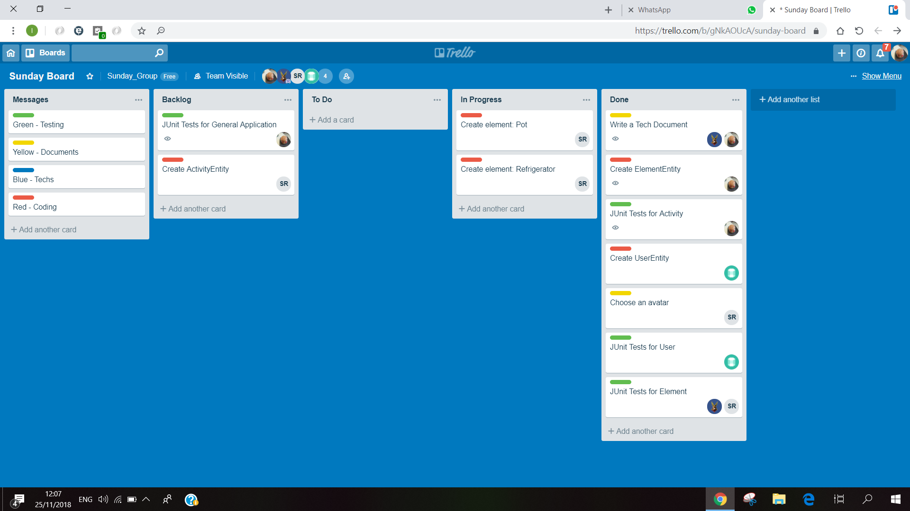
Sprint 3 end

